Slide 1
SMS Spam Collection
MACHINE LEARNING FINAL PROJECT
Proposal By
Nikhith Krishna Vinduru

Slide 2
CONTENTS:
Project's Input Data Description
Summary of Models Expected to Be Built
Conclusion
Dataset Link

Slide 3
DESCRIPTION:
The dataset contains [describe the data, e.g., text messages for spam classification]. It includes [mention key columns, e.g., "v1" for labels and "v2" for text messages].
Format: The data is provided in a CSV file with encoding 'ISO-8859-1'.
Size: The dataset consists of 5574 samples.

Slide 4
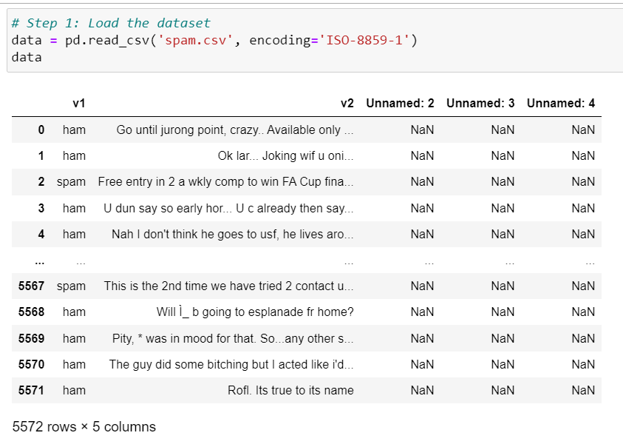
INDPUT DATA:

Slide 5
SUMMARY OF MODELS:
Data Preprocessing: The input text data will be pre-processed using TF-IDF vectorization, transforming text messages into numerical features. Labels will be encoded using Label Encoding.
Model Selection: We will experiment with several classification models, starting with Logistic Regression as an example. Other models like Random Forest, Support Vector Machine, and Naive Bayes will be considered.
Model Training: The selected model (e.g., Logistic Regression, Random Forest) will be trained on the pre-processed data.
Model Evaluation: The model's performance will be assessed using accuracy and a classification report. The report will include metrics like precision, recall, and F1-score for both "ham" and "spam" classes.

Slide 6
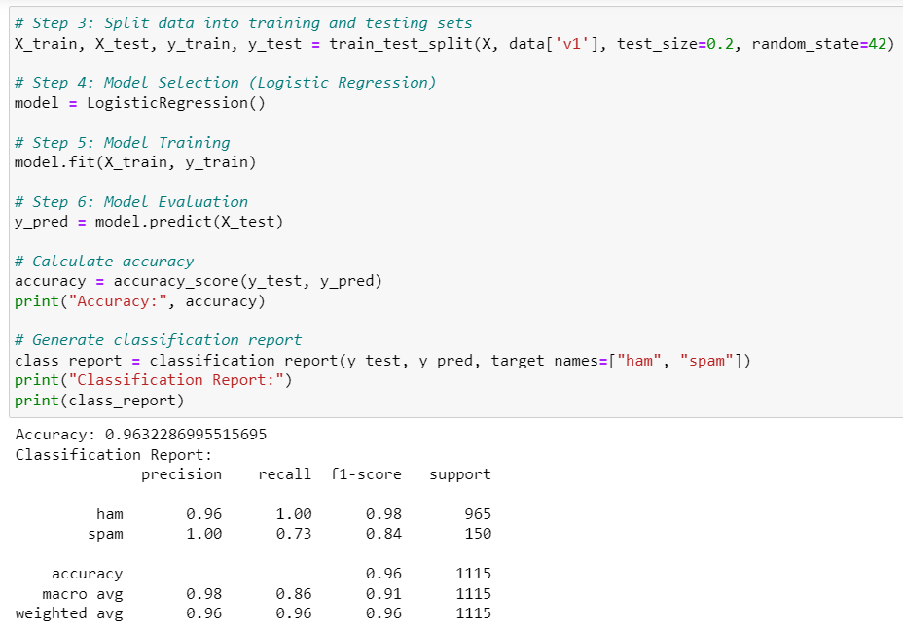
LOGISTIC REGRESSION:

Slide 7
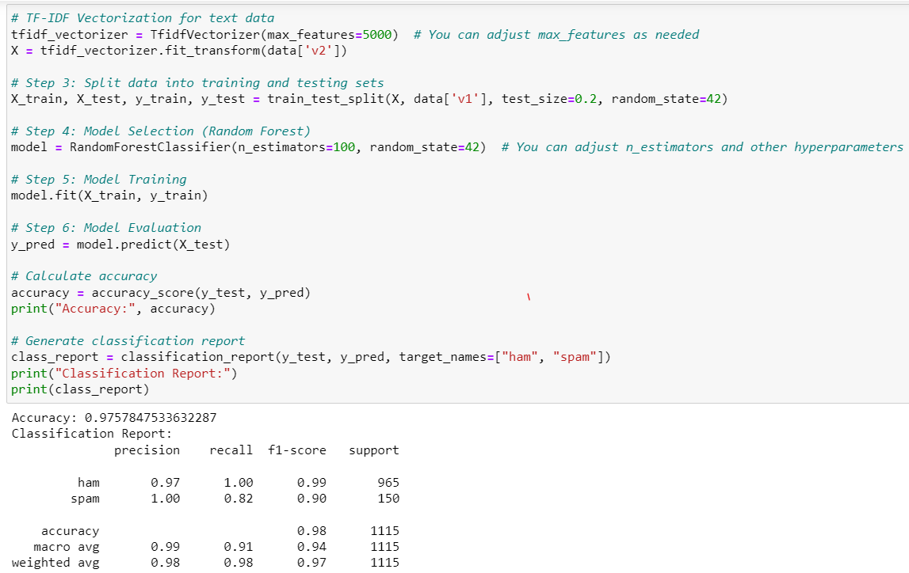
RANDOM FOREST:

Slide 8
CONCLUSION:
In conclusion, the project successfully demonstrated the effectiveness of machine learning in classifying text messages into 'ham' and 'spam'. Leveraging the power of TF-IDF vectorization for data preprocessing and experimenting with various models including Logistic Regression, Random Forest the project culminated in the development of a robust model. Random Forest model, characterized by high accuracy and strong performance metrics such as precision, recall, and F1-score, proves essential for enhancing the security and user experience in digital messaging. It marks a significant step in applying advanced machine learning techniques to the practical challenge of spam detection, setting a foundation for further innovations in the field.

Slide 9
DATA SET LINK:
https://www.kaggle.com/datasets/uciml/sms-spam-collection-dataset/

Slide 10

THANK YOU

